Slide 1
KINDERGARTEN MANAGEMENT SYSTEM
GROUP 15
Illya natasya binti huzair (f1010)
Nur adiela binti mohd ghaus (f1014)
Fatin nur izzati binti moharizal (f1058)

Slide 2
Progress of Project Development
Success of developing for our objective number 1 which is to develop a web based system for kindergarten attendance management by tap the tag at the RFID reader.
Success of developing for our objective number 2 which is to develop a web based system for Parents to check whether they had done their payment.
Success of developing for our objective number 3 which is to manage monthly attendance record list and check school’s fee.

Slide 3
INTERFACE FOR ADMIN

Slide 4
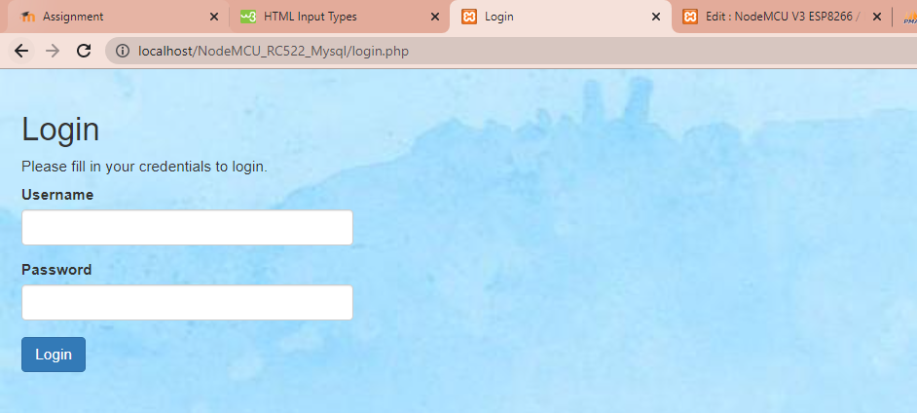
Slide 4

Slide 5
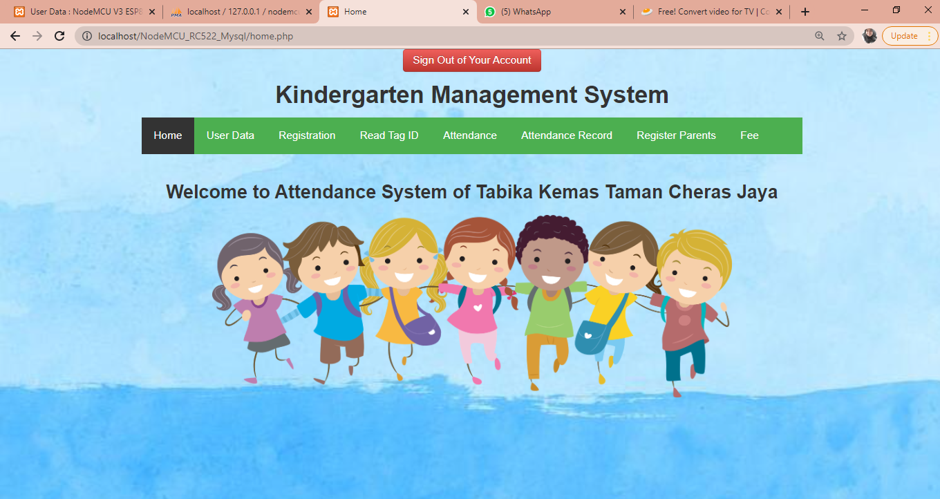
Slide 5
Slide 8
Slide 9
Slide 10

Slide 6
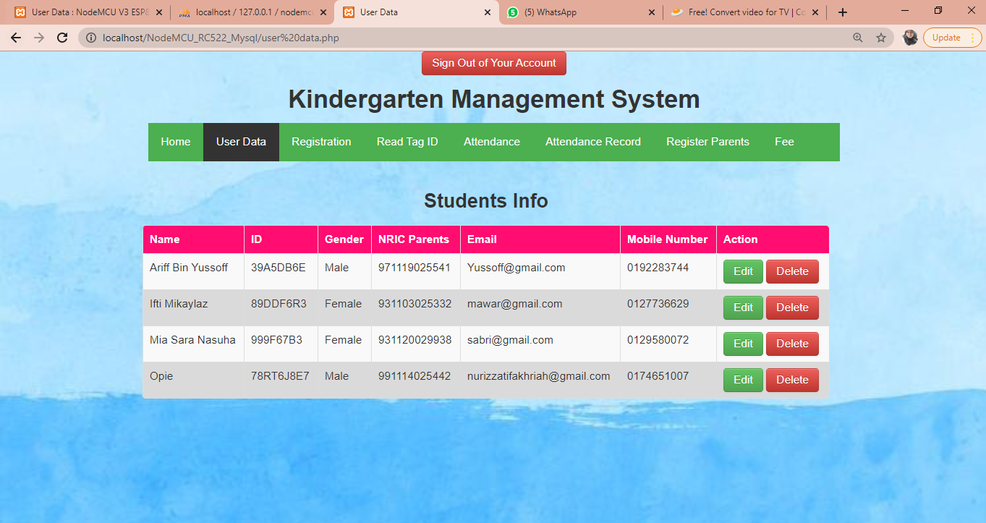
Slide 6
Slide 7

Slide 7
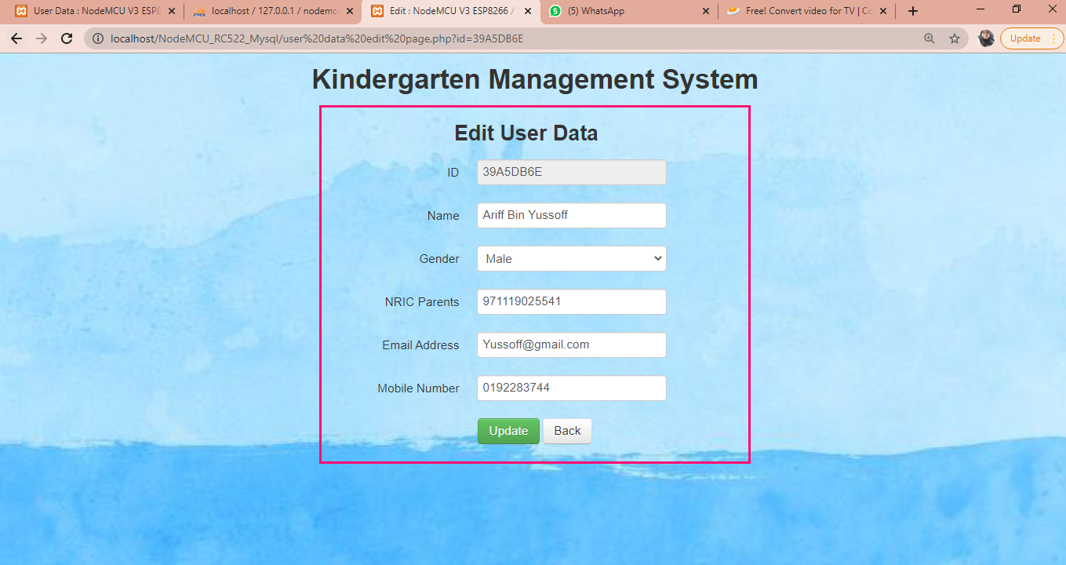
Slide 5

Slide 8
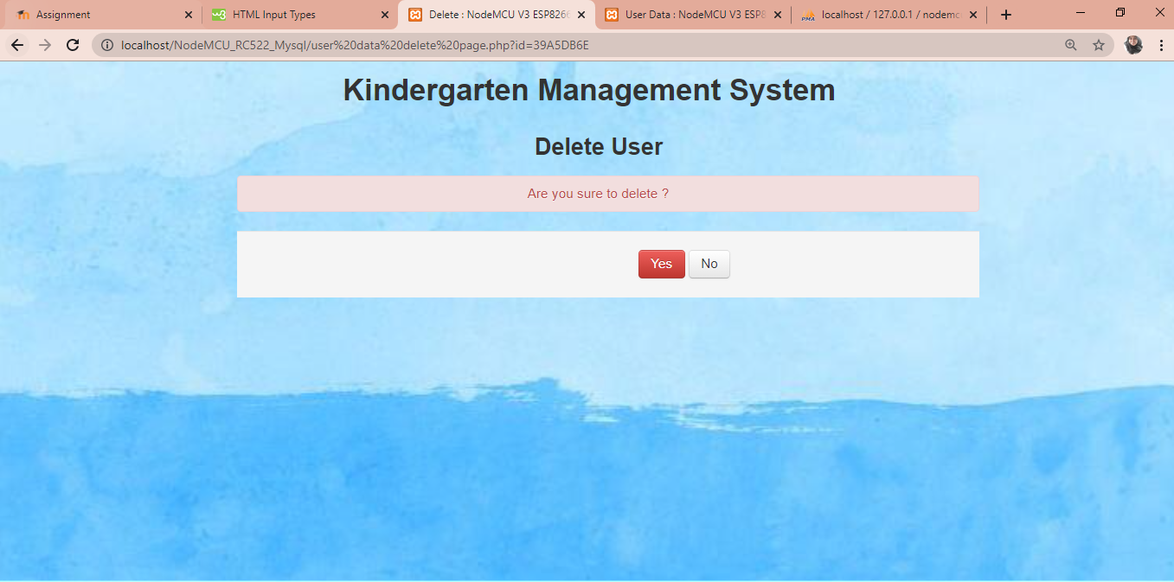

Slide 9
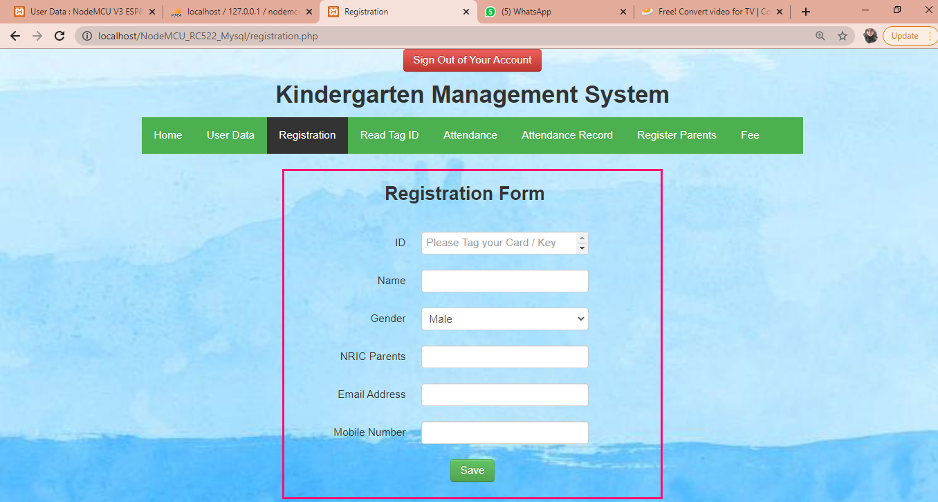

Slide 10
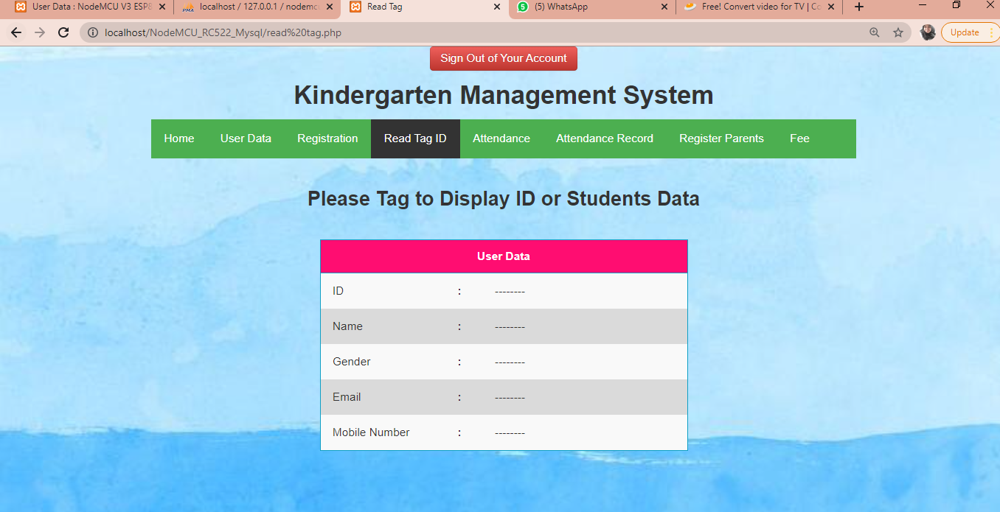

Slide 11
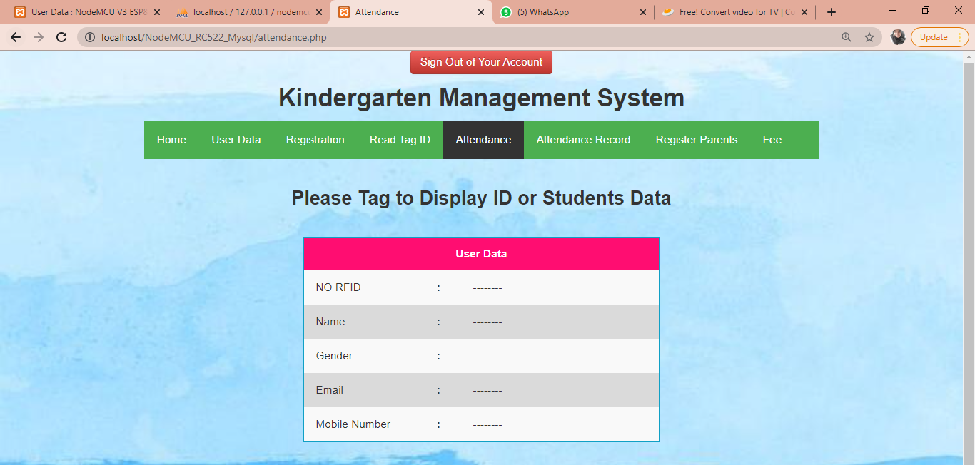
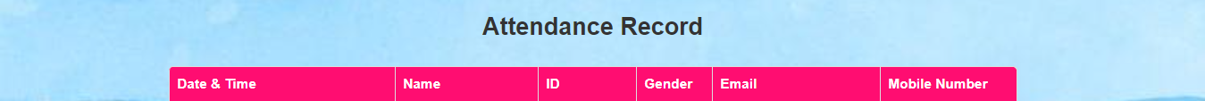


Slide 12
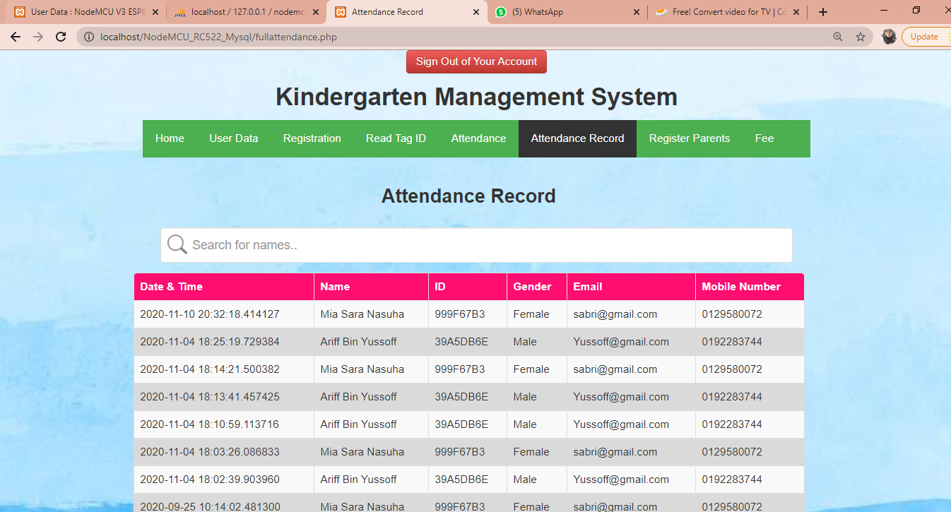

Slide 13
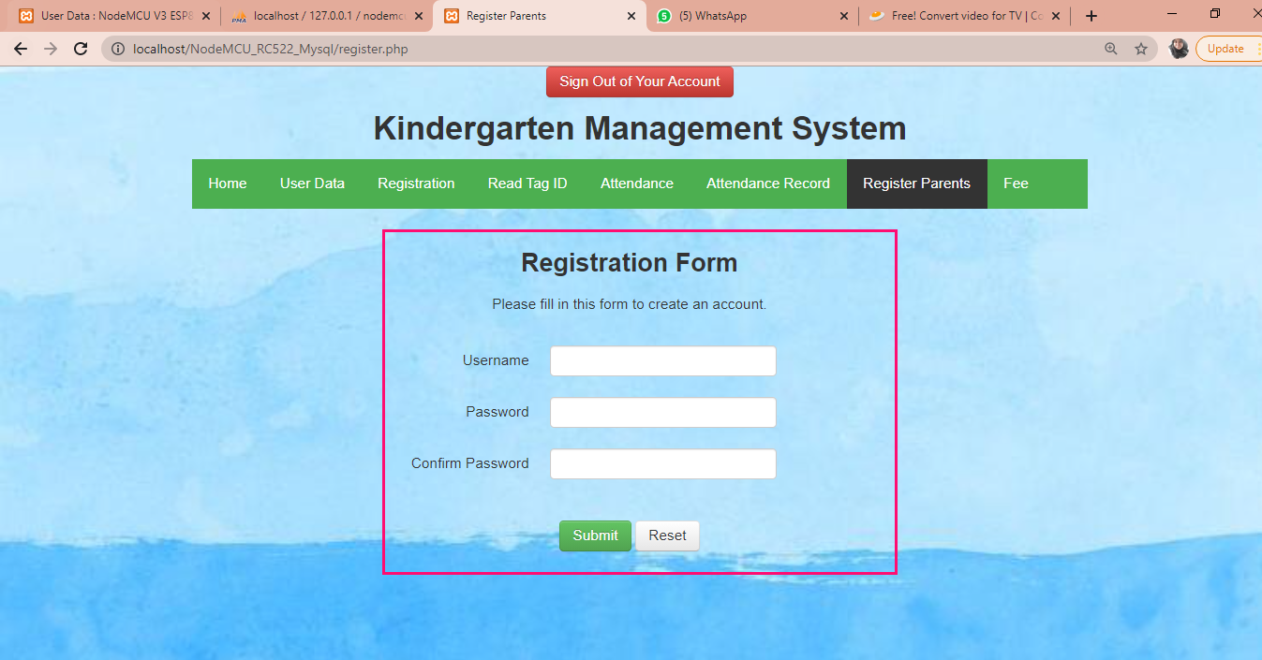

Slide 14
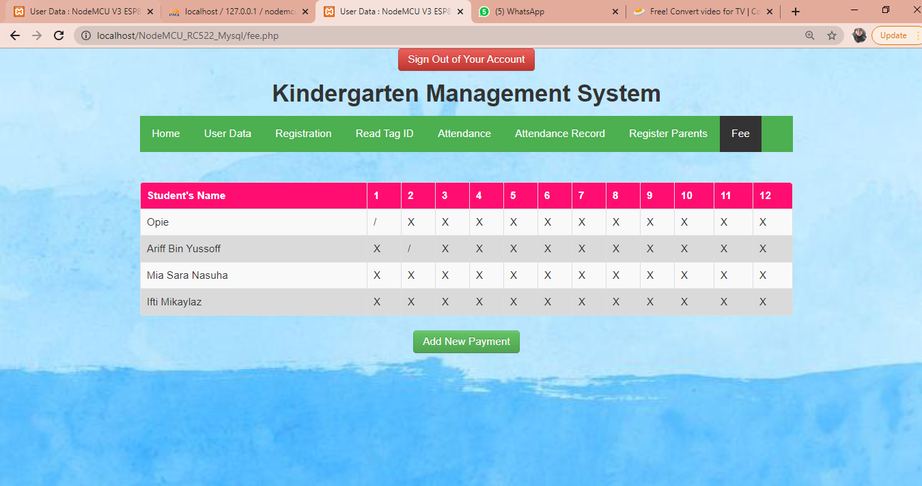

Slide 15
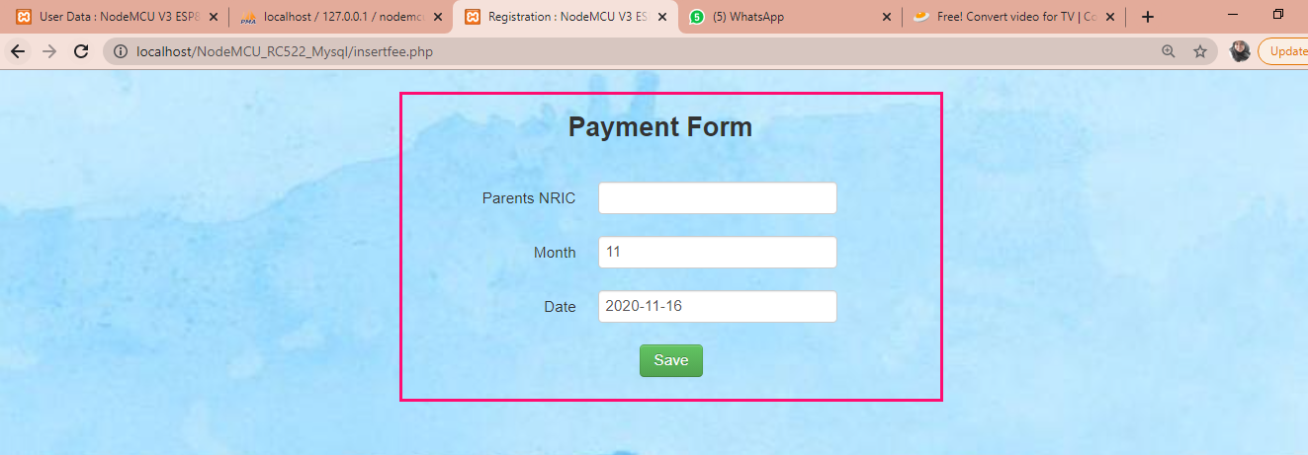

Slide 16
INTERFACE FOR PARENTS

Slide 18
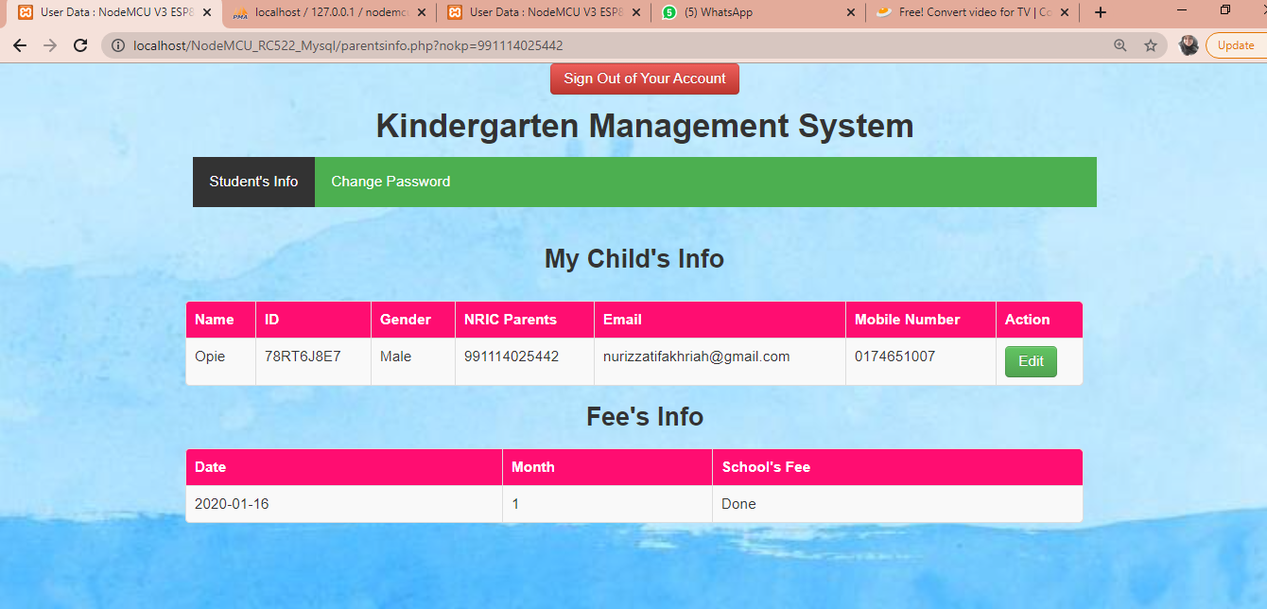

Slide 19
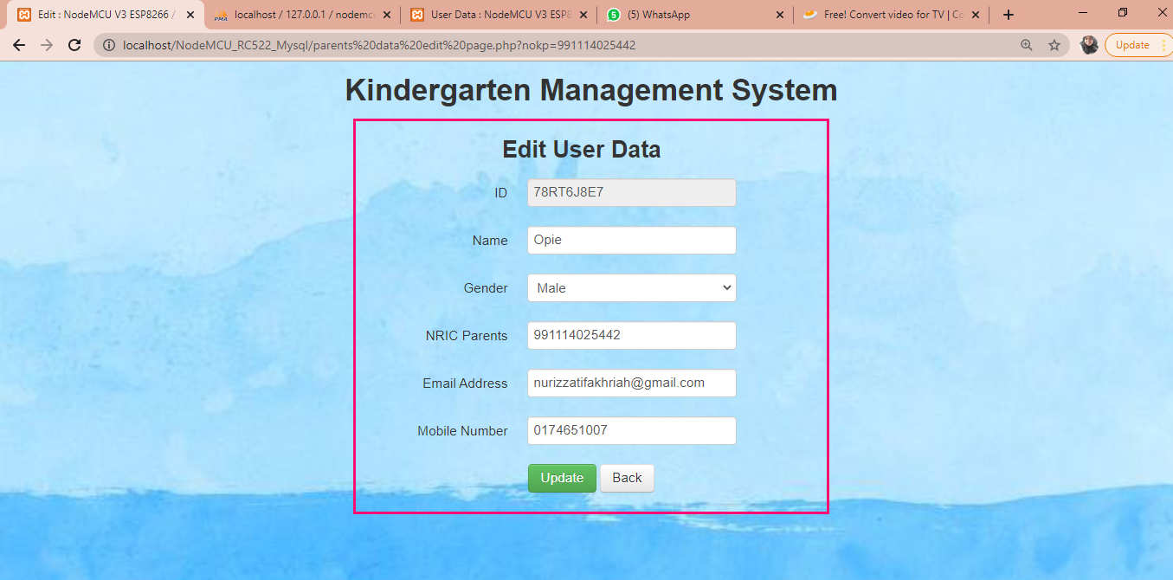

Slide 20
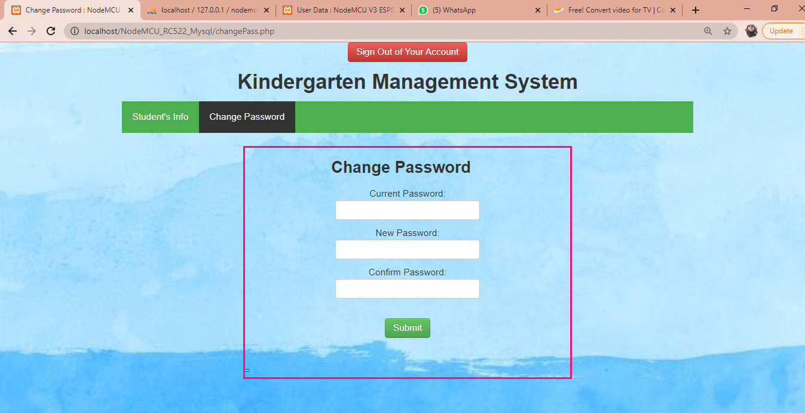

Slide 21
Content and Concept of Project
Problem statement
1
2
3
Teachers need to record attendance manually in the book.
Wasting a lot of time recording attendance in a book.
Possibilities attendance book will missing are high.
4
5
Wasting money and not systematic.
A lot of work to do by teachers.

Slide 22
Objectives
To develop a web based system for kindergarten attendance management by tap the tag at the RFID reader.
To make a web based system for parents as a reminder to check whether they had done their payment or not.
To manage monthly attendance record list and check school’s fee.

Slide 23
SYSTEM SECURITY AND FEATURES
1
Parents can login on the web system if only Admin are registered them. So this is a good security features because if parents or strangers can register by themselves, this system are proven not safe to use. Anyone can be register without control. But when it is just Admin can register new user, there will be only certain people can login and use the system.

Slide 24
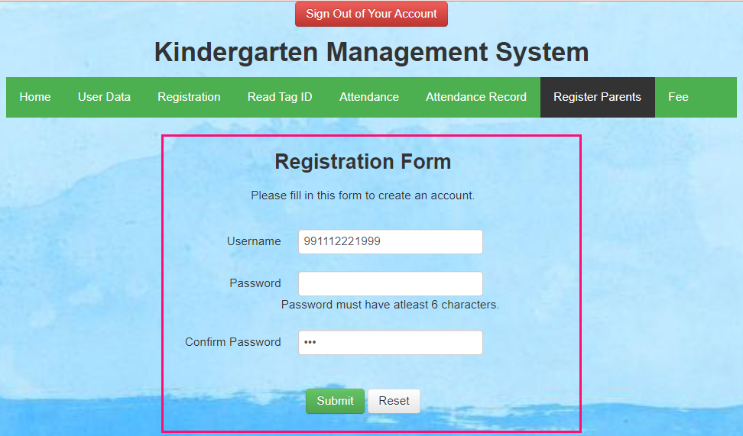
Password
Management
2
This web based system will popup a notification if Admin setup his/her password less than 6 character. A password should consist of at least six characters in this web based system.

Slide 25
TESTING

Slide 26
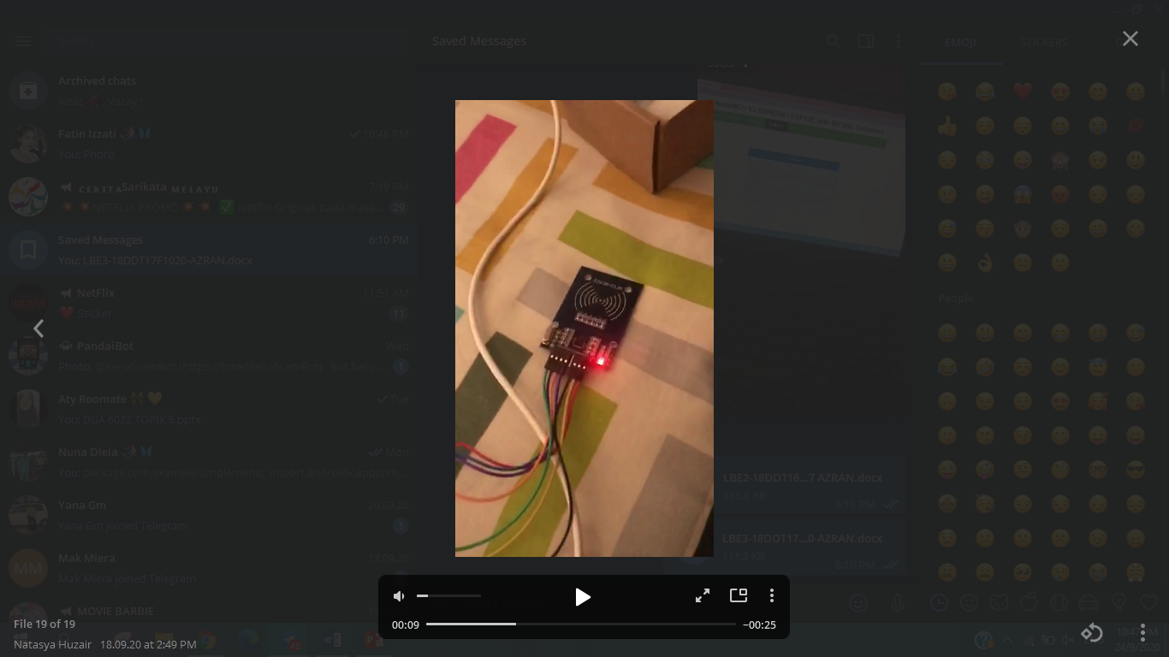
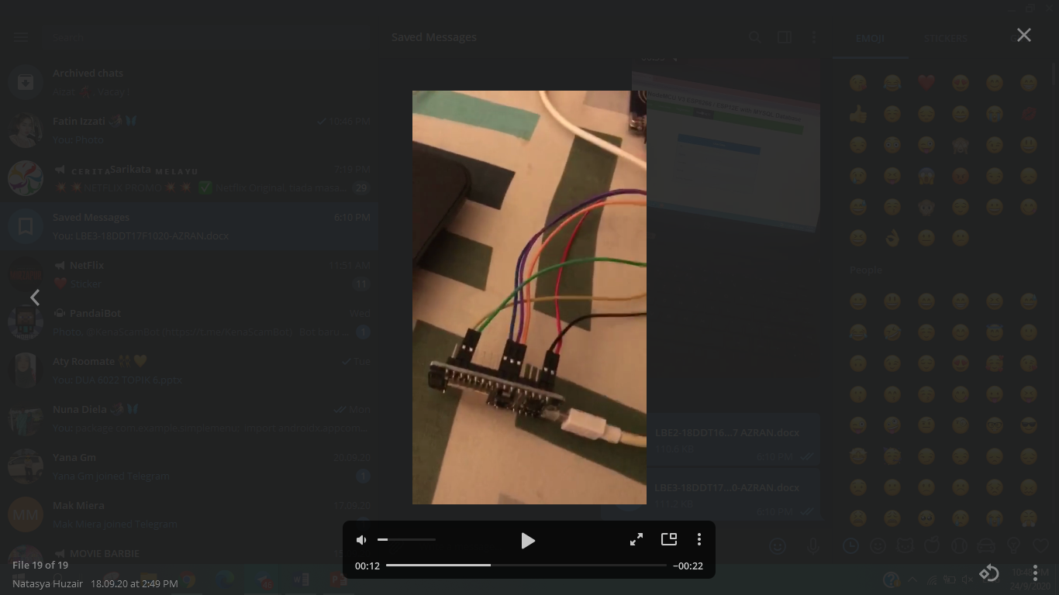
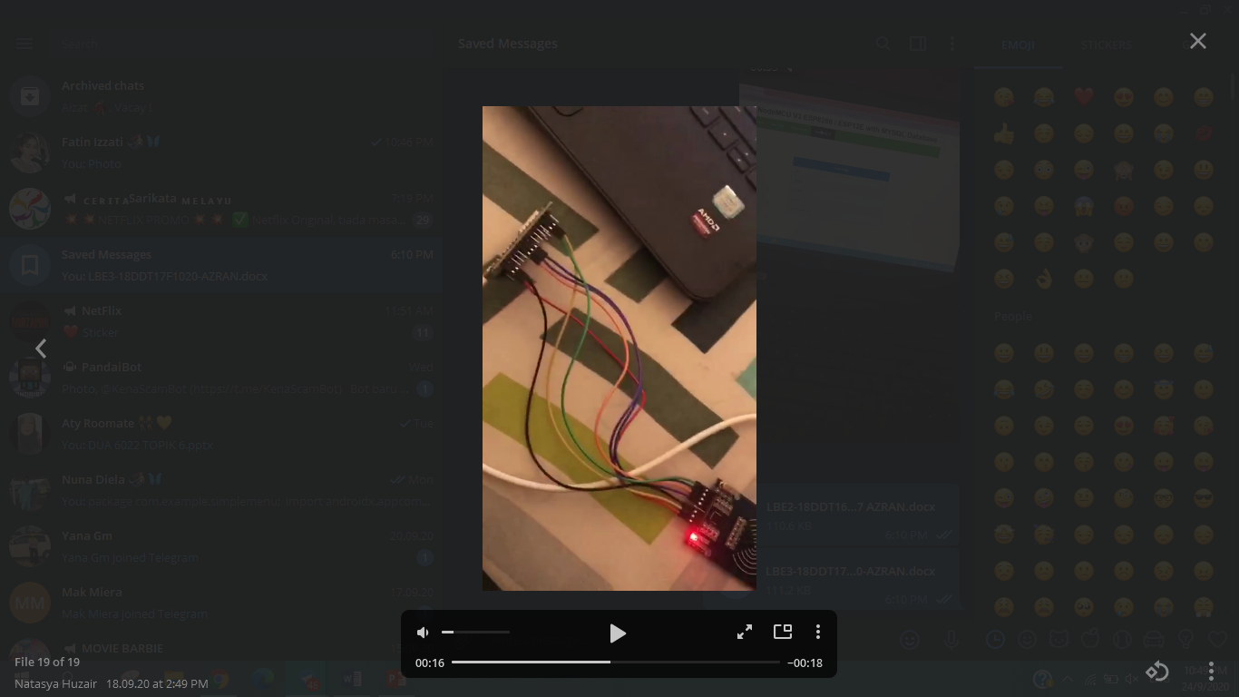
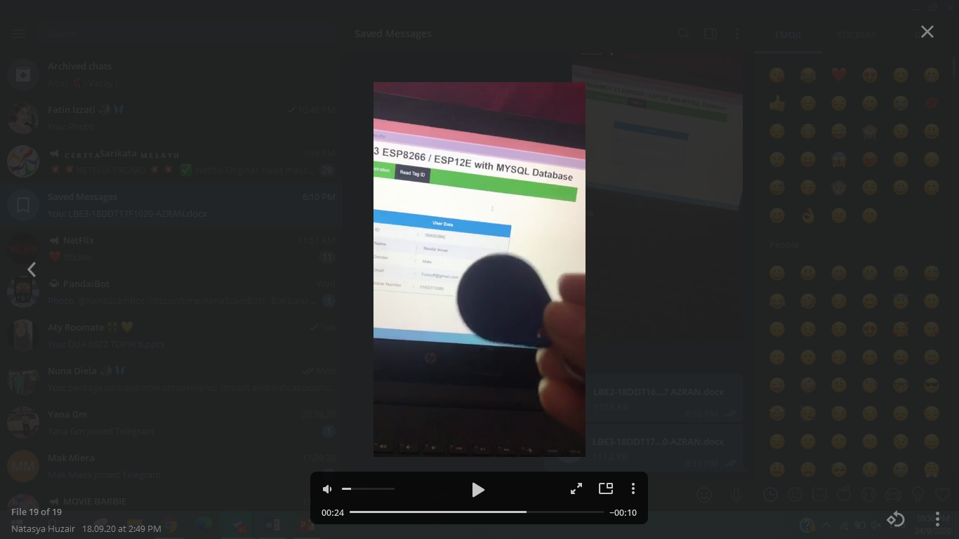

Slide 27
Thank You

